Slide 1
Vue TypeScript

Slide 2
What You Will Learn
TypeScript
Vue as a SPA Framework
Annotating Vue Options

Slide 3
TypeScript

Slide 4
What is TypeScript?
TypeScript
an open-source language which builds on JavaScript, one of the world’s most used tools, by adding static type definitions.

Slide 5
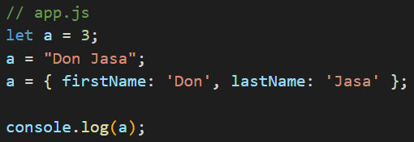
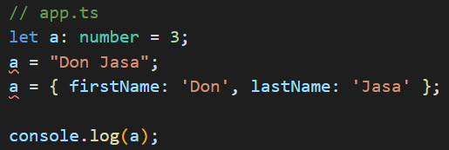
Why TypeScript?
TypeScript
Types provide a way to describe the shape of an object, providing better documentation, and allowing TypeScript to validate that your code is working correctly.
Notes:
Notice the squiggly lines in the example below

Slide 6
TypeScript is still JavaScript in the end
TypeScript
TypeScript isn’t the code that would actually run in the browser. It is transformed into JavaScript code via the TypeScript transpiler or Babel
Notes:
The browser DOES NOT understand TypeScript but it understands JavaScript
Maybe when debugging you’ll still see your code in TypeScript

Slide 7
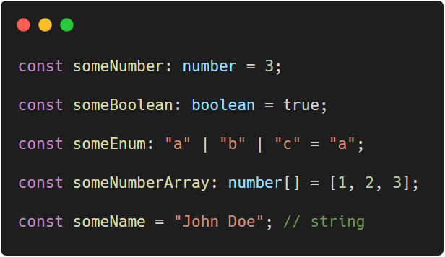
Type Annotations
TypeScript
When you declare a variable using const, var, or let, you can optionally add a type annotation to explicitly specify the type of the variable
Notes:
Notice on the last part, there is no annotation. TypeScript automatically gets the type when the variable has been assigned a value
JavaScript Code: https://carbon.now.sh/?bg=rgba%28255%2C255%2C255%2C1%29&t=vscode&wt=none&l=javascript&ds=false&dsyoff=20px&dsblur=68px&wc=true&wa=true&pv=56px&ph=56px&ln=false&fl=1&fm=Hack&fs=14px&lh=133%25&si=false&es=2x&wm=false&code=const%2520someNumber%253A%2520number%2520%253D%25203%253B%250A%250Aconst%2520someBoolean%253A%2520boolean%2520%253D%2520true%253B%250A%250Aconst%2520someEnum%253A%2520%2522a%2522%2520%257C%2520%2522b%2522%2520%257C%2520%2522c%2522%2520%253D%2520%2522a%2522%253B%250A%250Aconst%2520someNumberArray%253A%2520number%255B%255D%2520%253D%2520%255B1%252C%25202%252C%25203%255D%253B%250A%250Aconst%2520someName%2520%253D%2520%2522John%2520Doe%2522%253B%2520%252F%252F%2520string

Slide 8
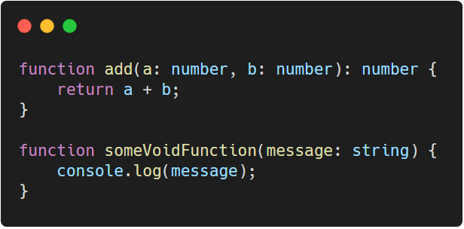
Type Annotations
TypeScript
TypeScript allows you to specify the types of both the input and output values of functions.
Notes:
You can use arrow functions, but since we can’t use them on Vue, we’re sticking with traditional declarations
TypeScript Code: https://carbon.now.sh/?bg=rgba%28255%2C255%2C255%2C1%29&t=vscode&wt=none&l=javascript&ds=false&dsyoff=20px&dsblur=68px&wc=true&wa=true&pv=56px&ph=56px&ln=false&fl=1&fm=Hack&fs=14px&lh=133%25&si=false&es=2x&wm=false&code=function%2520add%28a%253A%2520number%252C%2520b%253A%2520number%29%253A%2520number%2520%257B%250A%2520%2520%2520%2520return%2520a%2520%252B%2520b%253B%250A%257D%250A%250Afunction%2520someVoidFunction%28message%253A%2520string%29%2520%257B%250A%2520%2520%2520%2520console.log%28message%29%253B%250A%257D

Slide 9
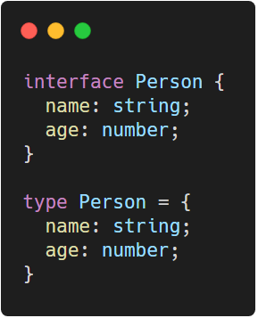
Object Types
TypeScript
In JavaScript, the fundamental way that we group and pass around data is through objects. In TypeScript, we represent those through object types.
Notes:
They can be named by using either interface or a type alias
TypeScript Code: https://carbon.now.sh/?bg=rgba%28255%2C255%2C255%2C1%29&t=vscode&wt=none&l=javascript&ds=false&dsyoff=20px&dsblur=68px&wc=true&wa=true&pv=56px&ph=56px&ln=false&fl=1&fm=Hack&fs=14px&lh=133%25&si=false&es=2x&wm=false&code=interface%2520Person%2520%257B%250A%2520%2520name%253A%2520string%253B%250A%2520%2520age%253A%2520number%253B%250A%257D%250A%250Atype%2520Person%2520%253D%2520%257B%250A%2520%2520name%253A%2520string%253B%250A%2520%2520age%253A%2520number%253B%250A%257D

Slide 10
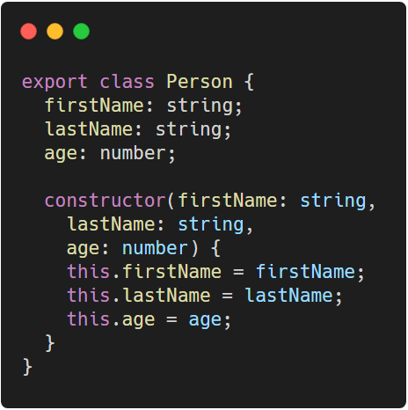
Class Types
TypeScript
As with other JavaScript language features, TypeScript adds type annotations and other syntax to classes
Notes:
TypeScript code: https://carbon.now.sh/?bg=rgba%28255%2C255%2C255%2C1%29&t=vscode&wt=none&l=javascript&ds=false&dsyoff=20px&dsblur=68px&wc=true&wa=true&pv=56px&ph=56px&ln=false&fl=1&fm=Hack&fs=14px&lh=133%25&si=false&es=2x&wm=false&code=export%2520class%2520Person%2520%257B%250A%2520%2520firstName%253A%2520string%253B%250A%2520%2520lastName%253A%2520string%253B%250A%2520%2520age%253A%2520number%253B%250A%250A%2520%2520constructor%28firstName%253A%2520string%252C%250A%2520%2520%2520%2520lastName%253A%2520string%252C%250A%2520%2520%2520%2520age%253A%2520number%29%2520%257B%250A%2520%2520%2520%2520this.firstName%2520%253D%2520firstName%253B%250A%2520%2520%2520%2520this.lastName%2520%253D%2520lastName%253B%250A%2520%2520%2520%2520this.age%2520%253D%2520age%253B%250A%2520%2520%257D%250A%257D

Slide 11
Vue as a SPA Framework

Slide 12
Using Vue CLI
Vue as a SPA Framework
Before proceeding to create Vue apps, vue cli must first be installed. To do so, run the command below via command line.
npm install --global @vue/cli

Slide 13
Using Vue CLI
Vue as a SPA Framework
After installing vue cli, go to a directory you’d like to create your project then run
vue create [appName]
Where [appName] is the name of your application

Slide 14
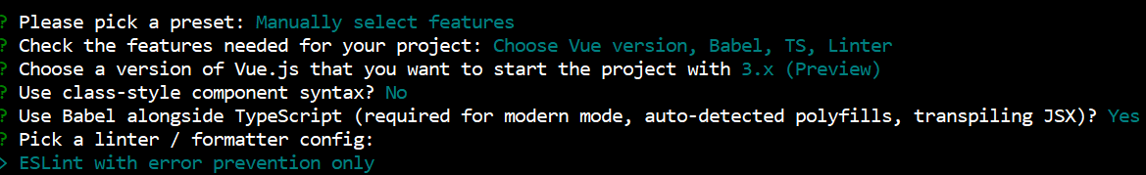
Using Vue CLI
Vue as a SPA Framework
There’s going to be options you can choose, select the following options:
Notes:
In order to tick typescript, press the spacebar

Slide 15
Adding Intellisense
Vue as a SPA Framework
To have intellisense available on your Vue application, in your VS Code, go to Extensions (Ctrl + Shift + X) then search and download Vetur
Vetur needs to be downloaded only once

Slide 16
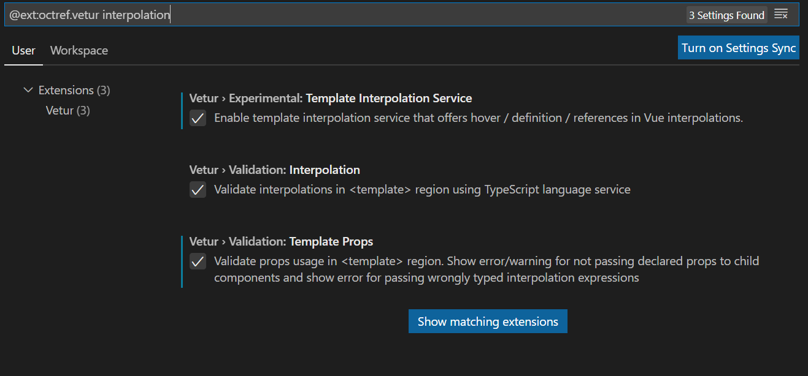
Vetur Settings
Vue as a SPA Framework
Notes:
Once Vetur has been integrated, modify its interpolation settings

Slide 17
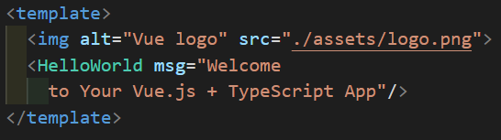
<template> tag
Vue as a SPA Framework
Every HTML and interpolations are placed inside the <template> tag.
This part gets rendered in the DOM
Notes:
Our focus would mostly be in the template and the script
Vue Code: https://carbon.now.sh/?bg=rgba%28255%2C255%2C255%2C1%29&t=vscode&wt=none&l=javascript&ds=false&dsyoff=20px&dsblur=68px&wc=true&wa=true&pv=56px&ph=56px&ln=false&fl=1&fm=Hack&fs=14px&lh=133%25&si=false&es=2x&wm=false&code=%253Ctemplate%253E%250A%252F%252F%2520HTML%2520template%250A%253C%252Ftemplate%253E%250A%250A%253Cscript%2520lang%253D%2522ts%2522%253E%250A%252F%252F%2520all%2520related%2520Vue%2520JS%2520Codes%250A%253C%252Fscript%253E%250A%250A%253Cstyle%253E%250A%252F%252F%2520css%2520stylings%250A%253C%252Fstyle%253E%250A

Slide 18
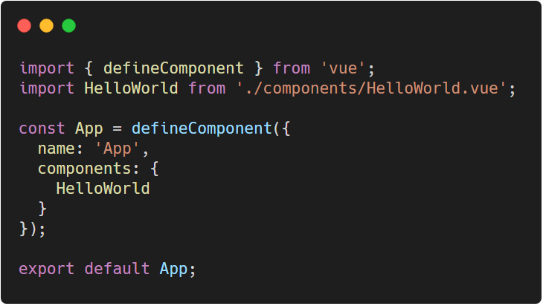
<script> tag
Vue as a SPA Framework
This is the part where we define our Vue configuration. Instead of createApp, defineComponent is used instead.
Notes:
Any JavaScript code is allowed inside the script tag BUT, it is required that there is one default export and that is the Vue configuration.
Explanations will be covered in Components
Every Vue option that was tackled on the previous lectures is available inside defineComponent
Code: https://carbon.now.sh/?bg=rgba%28255%2C255%2C255%2C1%29&t=vscode&wt=none&l=javascript&ds=false&dsyoff=20px&dsblur=68px&wc=true&wa=true&pv=56px&ph=56px&ln=false&fl=1&fm=Hack&fs=14px&lh=133%25&si=false&es=2x&wm=false&code=import%2520%257B%2520defineComponent%2520%257D%2520from%2520%27vue%27%253B%250Aimport%2520HelloWorld%2520from%2520%27.%252Fcomponents%252FHelloWorld.vue%27%253B%250A%250Aconst%2520App%2520%253D%2520defineComponent%28%257B%250A%2520%2520name%253A%2520%27App%27%252C%250A%2520%2520components%253A%2520%257B%250A%2520%2520%2520%2520HelloWorld%250A%2520%2520%257D%250A%257D%29%253B%250A%250Aexport%2520default%2520App%253B

Slide 19
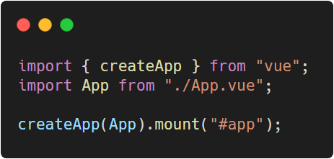
Main.ts
Vue as a SPA Framework
main.ts is the entry point of the application. This is where most of app injections take place.
Notes:
Injections to be discussed as we go along
This is where the createApp is..
Code: https://carbon.now.sh/?bg=rgba%28255%2C255%2C255%2C1%29&t=vscode&wt=none&l=javascript&ds=false&dsyoff=20px&dsblur=68px&wc=true&wa=true&pv=56px&ph=56px&ln=false&fl=1&fm=Hack&fs=14px&lh=133%25&si=false&es=2x&wm=false&code=import%2520%257B%2520createApp%2520%257D%2520from%2520%2522vue%2522%253B%250Aimport%2520App%2520from%2520%2522.%252FApp.vue%2522%253B%250A%250AcreateApp%28App%29.mount%28%2522%2523app%2522%29%253B

Slide 20
Annotating Vue Options

Slide 21
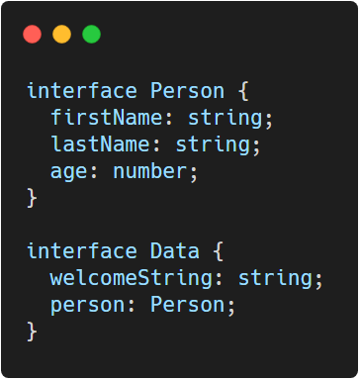
Annotating Options - data
Annotating Vue Options
To have a type check for the data, simply declare interface(s) that the data object should return then annotate it
Notes:
Code: https://carbon.now.sh/?bg=rgba%28255%2C255%2C255%2C1%29&t=vscode&wt=none&l=javascript&ds=false&dsyoff=20px&dsblur=68px&wc=true&wa=true&pv=56px&ph=56px&ln=false&fl=1&fm=Hack&fs=14px&lh=133%25&si=false&es=2x&wm=false&code=interface%2520Person%2520%257B%250A%2520%2520firstName%253A%2520string%253B%250A%2520%2520lastName%253A%2520string%253B%250A%2520%2520age%253A%2520number%253B%250A%257D%250A%250Ainterface%2520Data%2520%257B%250A%2520%2520welcomeString%253A%2520string%253B%250A%2520%2520person%253A%2520Person%253B%250A%257D

Slide 22
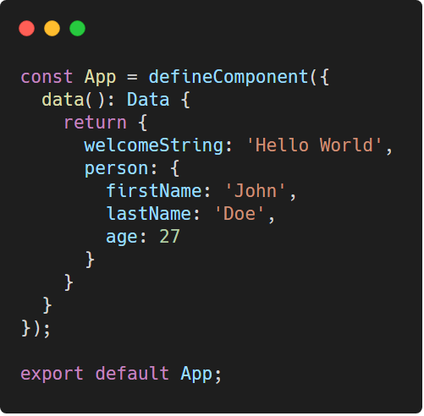
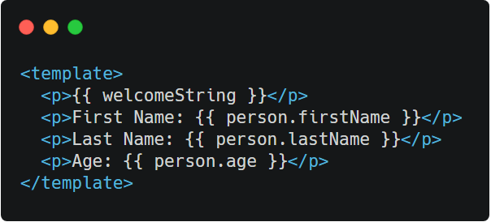
Annotating Options - data
Annotating Vue Options
Notes:
Sadly, intellisense for interpolations isn’t supported yet. Do remember that TypeScript can automatically detect a type when a value has been initialized. Hence, annotating Data may actually be considered optional.
Script: https://carbon.now.sh/?bg=rgba%28255%2C255%2C255%2C1%29&t=vscode&wt=none&l=javascript&ds=false&dsyoff=20px&dsblur=68px&wc=true&wa=true&pv=56px&ph=56px&ln=false&fl=1&fm=Hack&fs=14px&lh=133%25&si=false&es=2x&wm=false&code=const%2520App%2520%253D%2520defineComponent%28%257B%250A%2520%2520data%28%29%253A%2520Data%2520%257B%250A%2520%2520%2520%2520return%2520%257B%250A%2520%2520%2520%2520%2520%2520welcomeString%253A%2520%27Hello%2520World%27%252C%250A%2520%2520%2520%2520%2520%2520person%253A%2520%257B%250A%2520%2520%2520%2520%2520%2520%2520%2520firstName%253A%2520%27John%27%252C%250A%2520%2520%2520%2520%2520%2520%2520%2520lastName%253A%2520%27Doe%27%252C%250A%2520%2520%2520%2520%2520%2520%2520%2520age%253A%252027%250A%2520%2520%2520%2520%2520%2520%257D%250A%2520%2520%2520%2520%257D%250A%2520%2520%257D%250A%257D%29%253B%250A%250Aexport%2520default%2520App%253B
HTML: https://carbon.now.sh/?bg=rgba%28255%2C255%2C255%2C1%29&t=seti&wt=none&l=htmlmixed&ds=false&dsyoff=20px&dsblur=68px&wc=true&wa=true&pv=56px&ph=56px&ln=false&fl=1&fm=Hack&fs=14px&lh=133%25&si=false&es=2x&wm=false&code=%253Ctemplate%253E%250A%2520%2520%253Cp%253E%257B%257B%2520welcomeString%2520%257D%257D%253C%252Fp%253E%250A%2520%2520%253Cp%253EFirst%2520Name%253A%2520%257B%257B%2520person.firstName%2520%257D%257D%253C%252Fp%253E%250A%2520%2520%253Cp%253ELast%2520Name%253A%2520%257B%257B%2520person.lastName%2520%257D%257D%253C%252Fp%253E%250A%2520%2520%253Cp%253EAge%253A%2520%257B%257B%2520person.age%2520%257D%257D%253C%252Fp%253E%250A%253C%252Ftemplate%253E

Slide 23
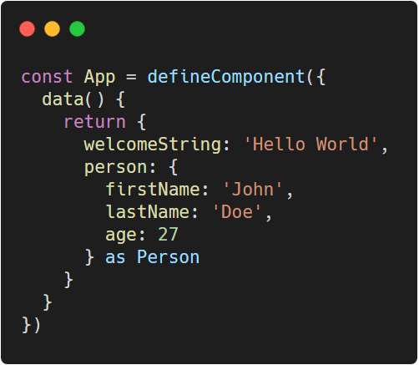
Annotating Options - data
Annotating Vue Options
It is also possible to select specific part of the data to annotate.
Notes:
Code: https://carbon.now.sh/?bg=rgba%28255%2C255%2C255%2C1%29&t=vscode&wt=none&l=javascript&ds=false&dsyoff=20px&dsblur=68px&wc=true&wa=true&pv=56px&ph=56px&ln=false&fl=1&fm=Hack&fs=14px&lh=133%25&si=false&es=2x&wm=false&code=const%2520App%2520%253D%2520defineComponent%28%257B%250A%2520%2520data%28%29%2520%257B%250A%2520%2520%2520%2520return%2520%257B%250A%2520%2520%2520%2520%2520%2520welcomeString%253A%2520%27Hello%2520World%27%252C%250A%2520%2520%2520%2520%2520%2520person%253A%2520%257B%250A%2520%2520%2520%2520%2520%2520%2520%2520firstName%253A%2520%27John%27%252C%250A%2520%2520%2520%2520%2520%2520%2520%2520lastName%253A%2520%27Doe%27%252C%250A%2520%2520%2520%2520%2520%2520%2520%2520age%253A%252027%250A%2520%2520%2520%2520%2520%2520%257D%2520as%2520Person%250A%2520%2520%2520%2520%257D%250A%2520%2520%257D%250A%257D%29

Slide 24
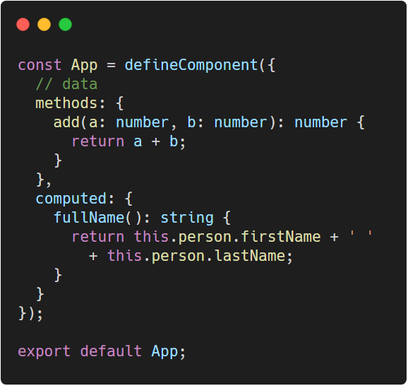
Annotating Options - methods and computed
Annotating Vue Options
Methods and computed options are the same in annotation as you would a function in TypeScript
Notes:
Code: https://carbon.now.sh/?bg=rgba%28255%2C255%2C255%2C1%29&t=vscode&wt=none&l=javascript&ds=false&dsyoff=20px&dsblur=68px&wc=true&wa=true&pv=56px&ph=56px&ln=false&fl=1&fm=Hack&fs=14px&lh=133%25&si=false&es=2x&wm=false&code=const%2520App%2520%253D%2520defineComponent%28%257B%250A%2520%2520%252F%252F%2520data%250A%2520%2520methods%253A%2520%257B%250A%2520%2520%2520%2520add%28a%253A%2520number%252C%2520b%253A%2520number%29%253A%2520number%2520%257B%250A%2520%2520%2520%2520%2520%2520return%2520a%2520%252B%2520b%253B%250A%2520%2520%2520%2520%257D%250A%2520%2520%257D%252C%250A%2520%2520computed%253A%2520%257B%250A%2520%2520%2520%2520fullName%28%29%253A%2520string%2520%257B%250A%2520%2520%2520%2520%2520%2520return%2520this.person.firstName%2520%252B%2520%27%2520%27%2520%250A%2520%2520%2520%2520%2520%2520%2520%2520%252B%2520this.person.lastName%253B%250A%2520%2520%2520%2520%257D%250A%2520%2520%257D%250A%257D%29%253B%250A%250Aexport%2520default%2520App%253B

Slide 25
Thank You
Up Next . . . Components Part 1

